Slide 1
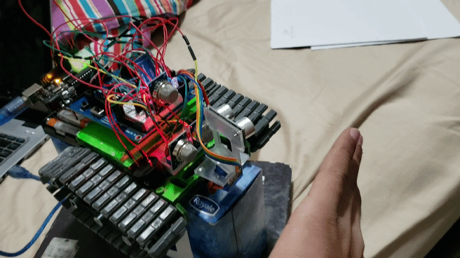
SmartBot
By: Ayush and Mahik

Slide 2

Define The Problem
Designers of the Toronto Fire Department have told us to create an autonomous robot which will detect various types of harmful gases inside confined spaces which are inaccessible to firefighters.

Slide 3
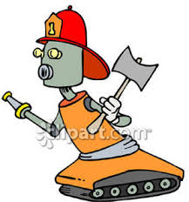
Requirements
The objective of this robot is to determine safe paths and determine gases inside different situations. In the line of fire, it is difficult to make way for firefighters to get inside areas and detect gases. Our design is supposed to include a minimal sized robot which can get inside these hard to reach areas. This must also include a sealed box which contains motorised doors. The box must allow a full clear vision of the inside.

Slide 4
Restrictions
Materials: Aluminum composite, Boe Shield, electronic sensors and other parts.
Time: Friday November 1st 2019 - Monday January 20th 2020
Gases to be detected: Hydrogen gas, Natural Gas, and CO₂
Budget: $0 - No material will be purchased
IRL Budget: $100 plus. This is due to the cost of the sensors, bluetooth module, BOE shield and other mechanical aspects.
Size: It should be as minimal as possible. Therefore, the robot should also be able to fit inside the designed sealed box to show demonstration.

Slide 5
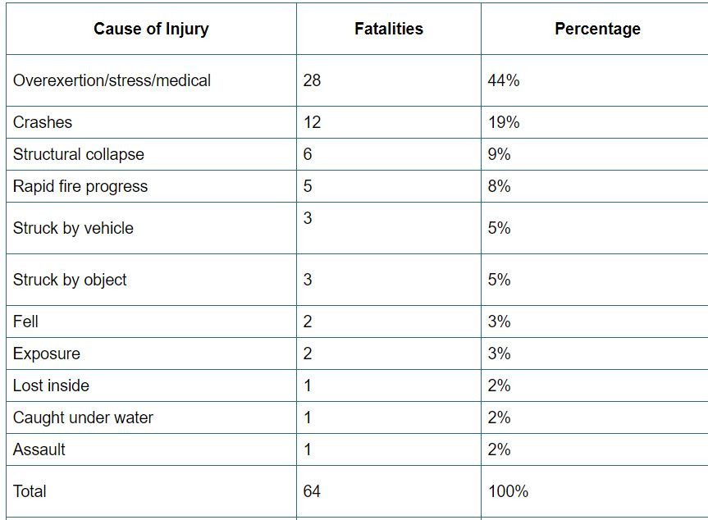
Background Research
According to NFPA, the risk of fire fighting injuries have only increased in the past few decades. These fatalities include overexertion, crashes, lost inside, exposure and etc.

Slide 6
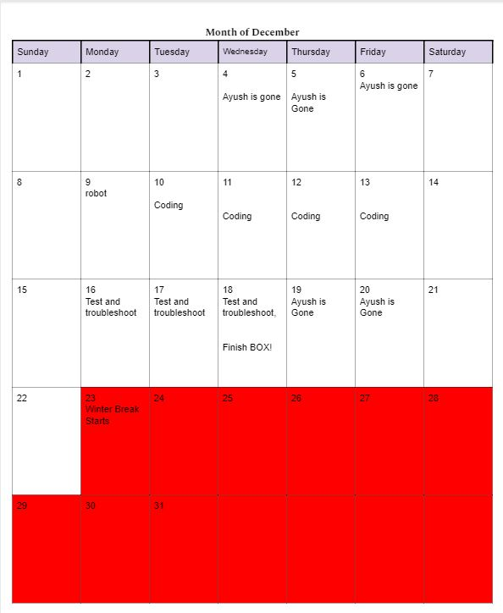
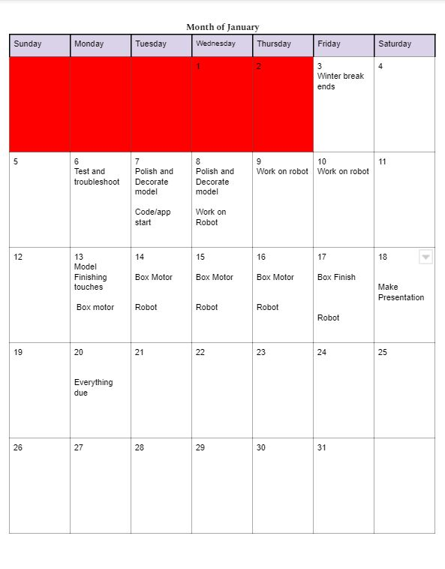
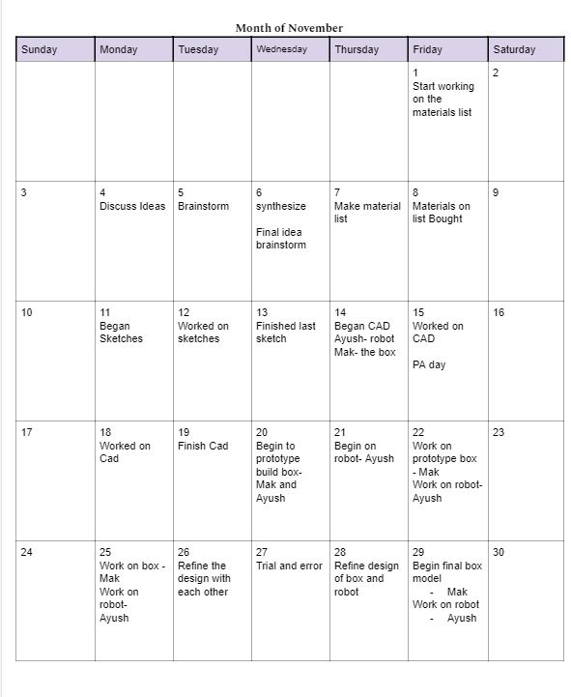
Investigation
Timeline:

Slide 7
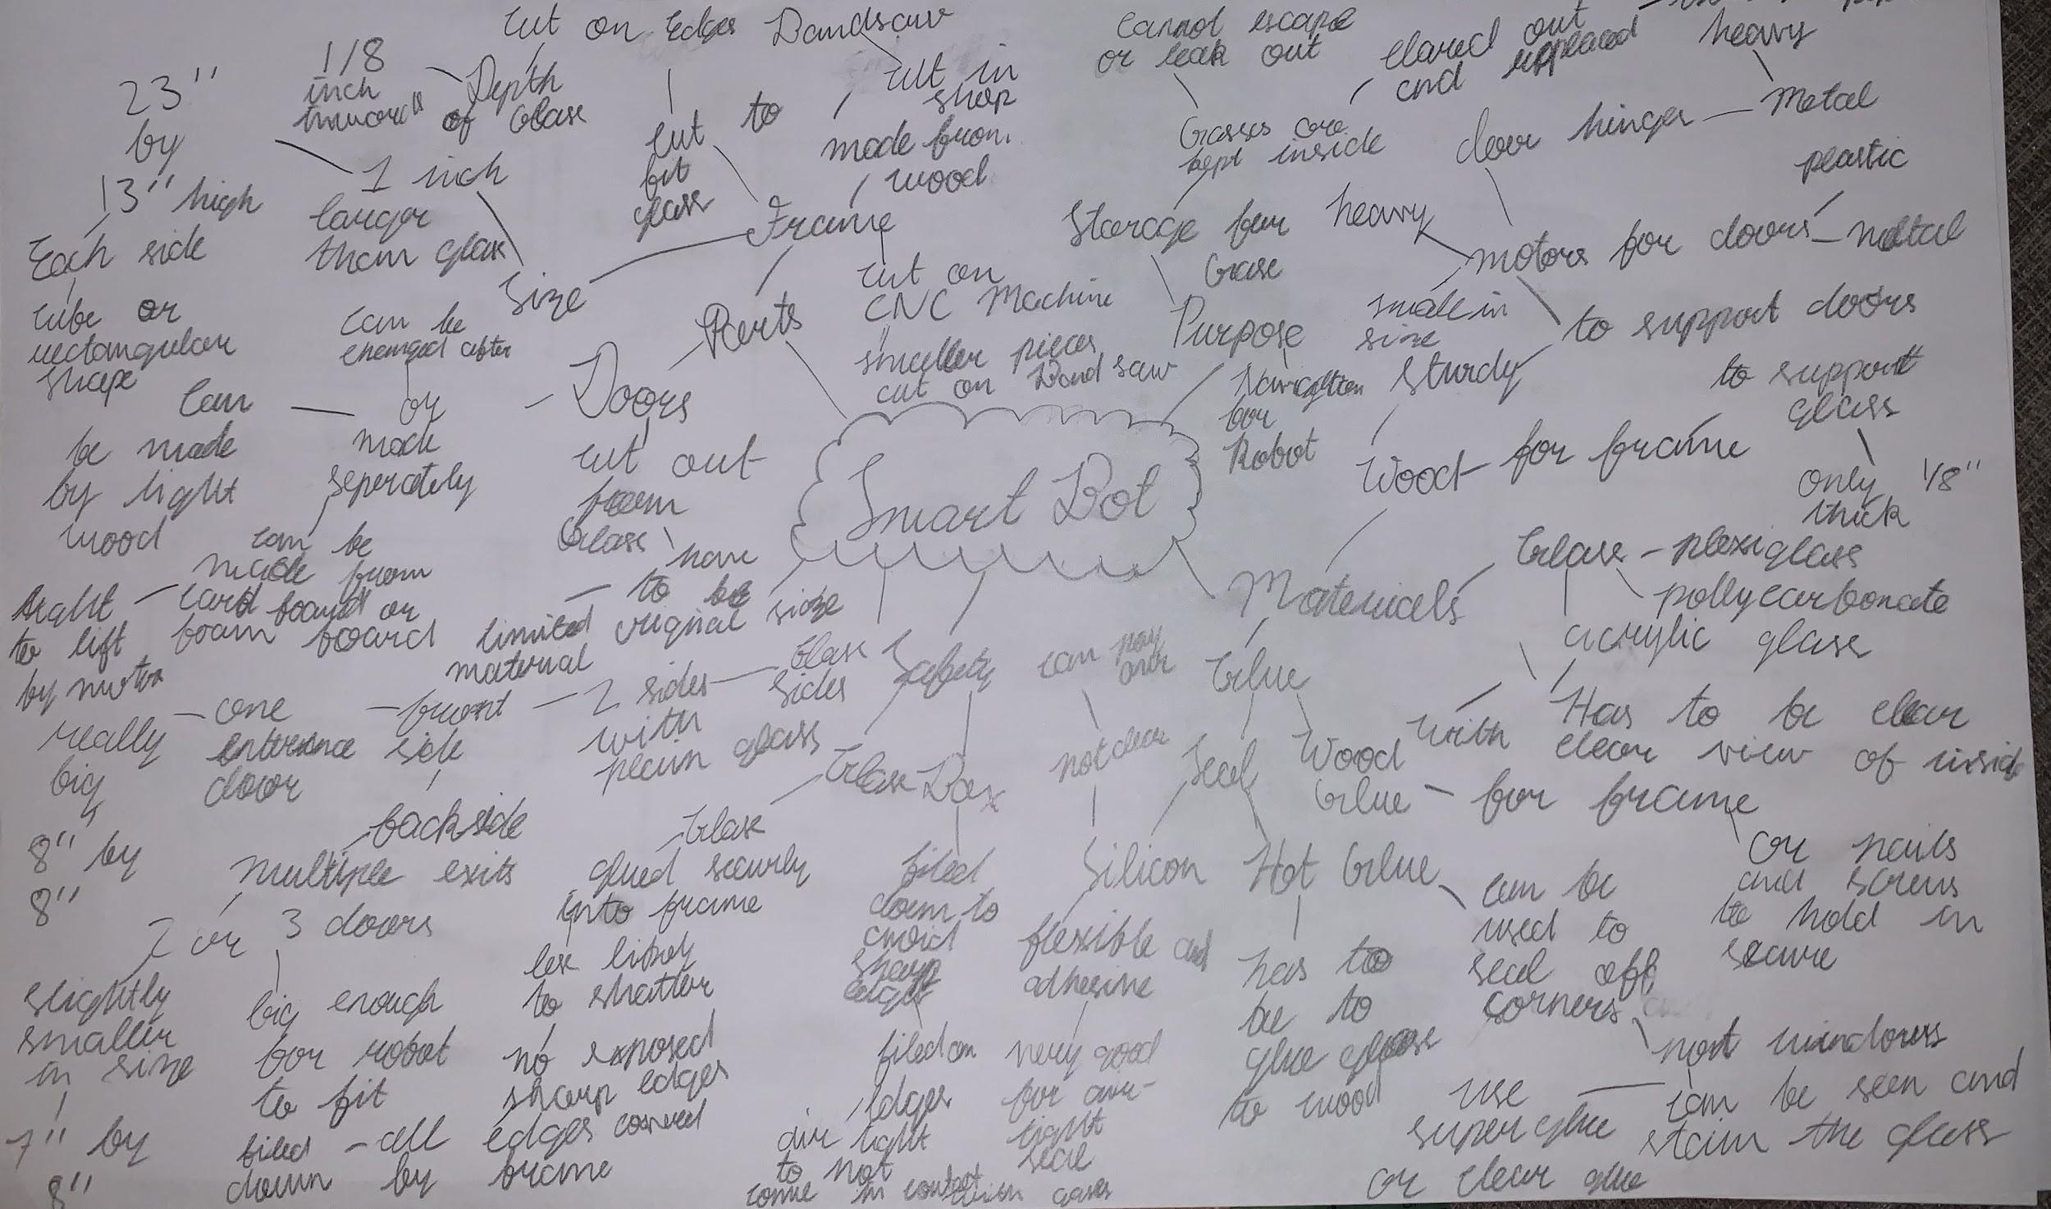
Mind Map - Box

Slide 8
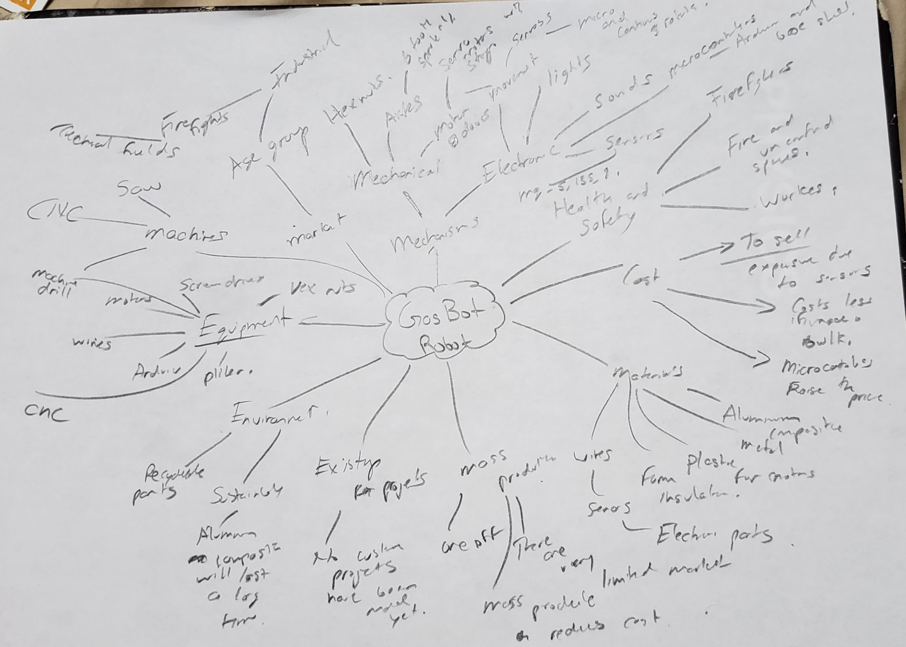
Mind Map - Robot

Slide 9
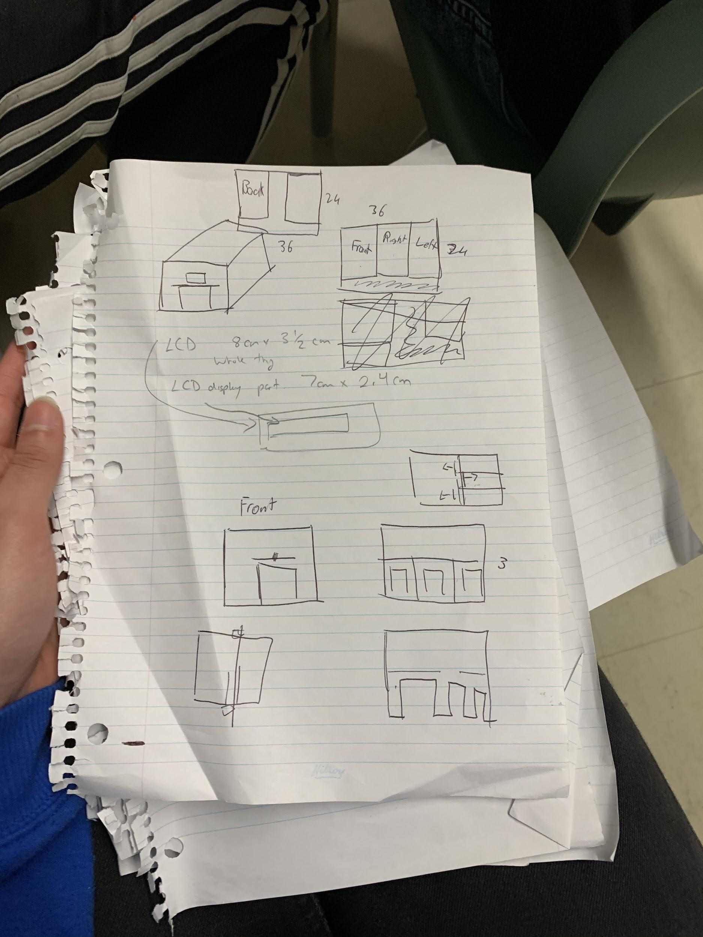
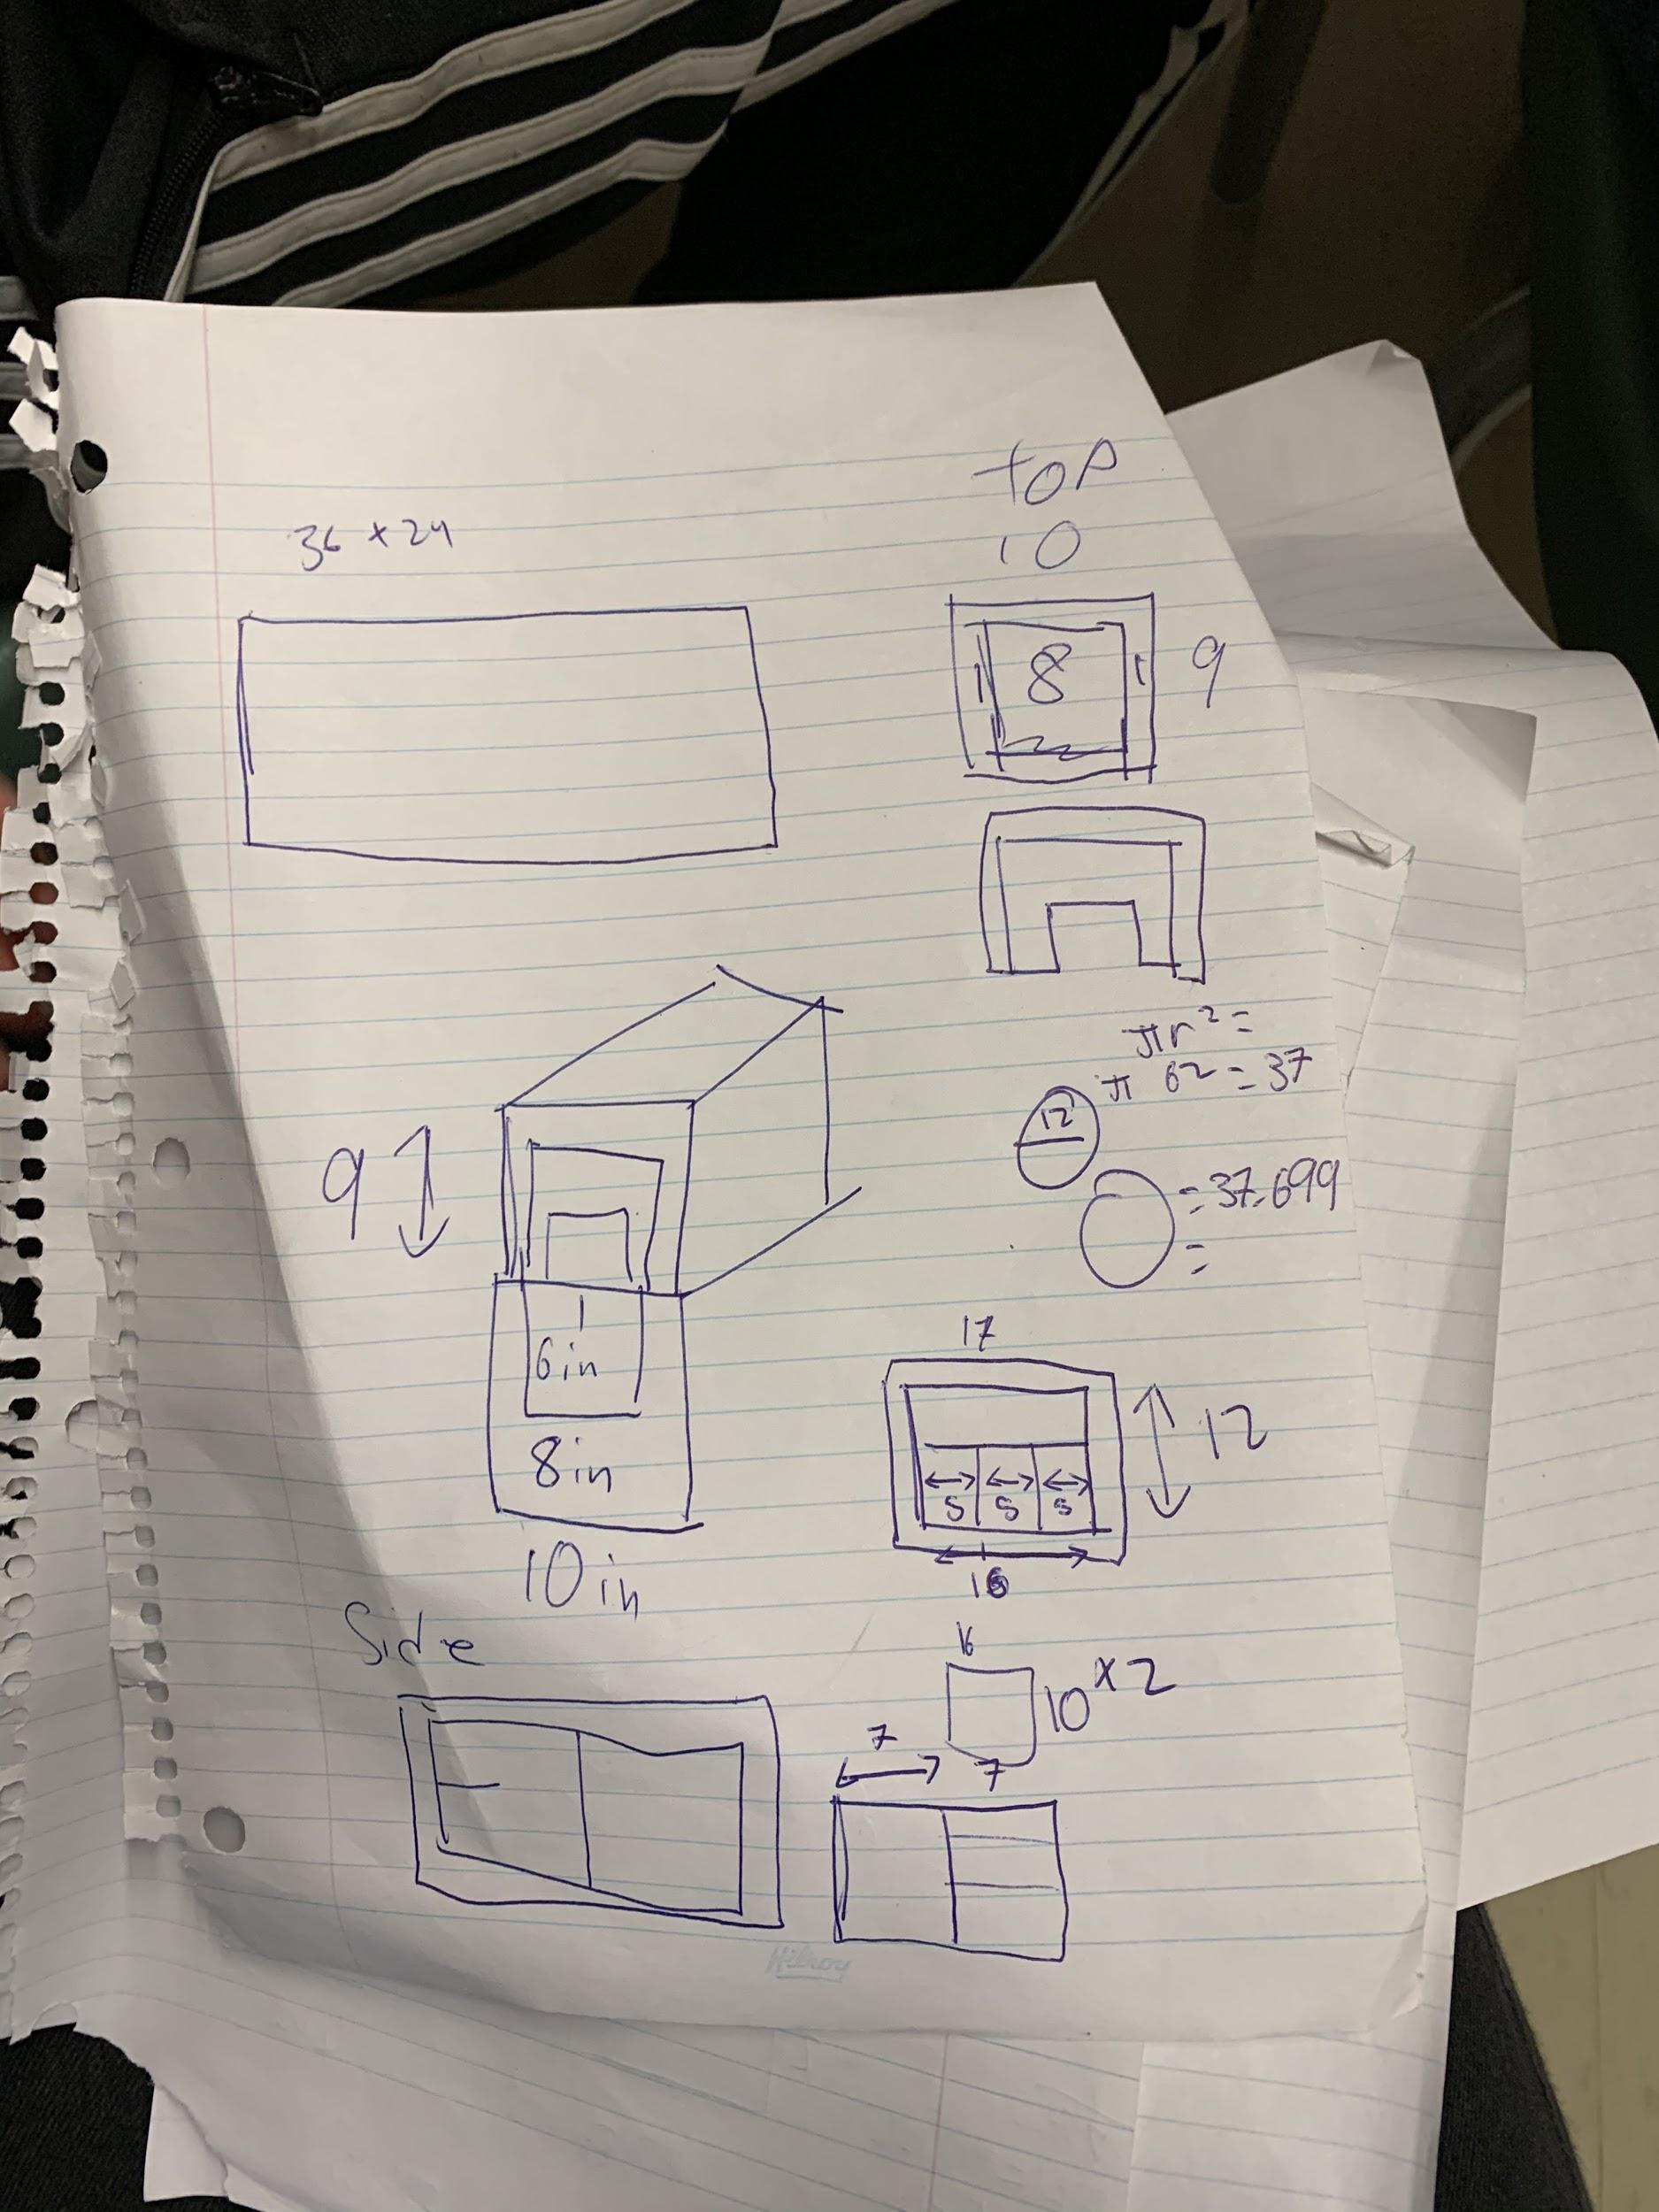
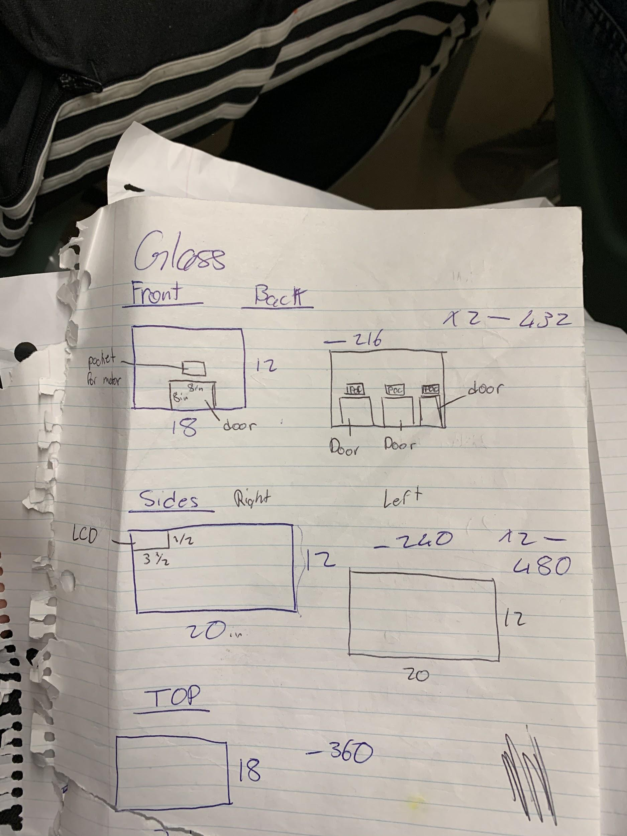
Rough sketches

Slide 10
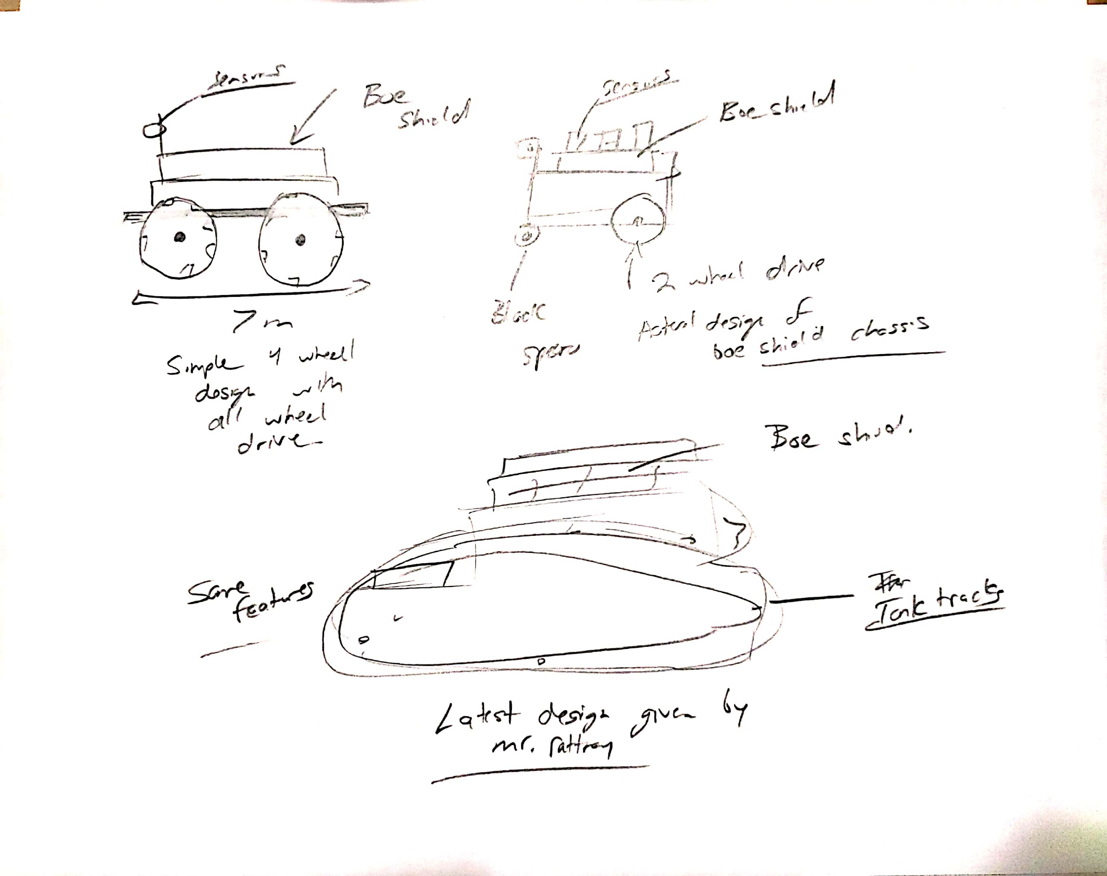
Sketches - Robot

Slide 11
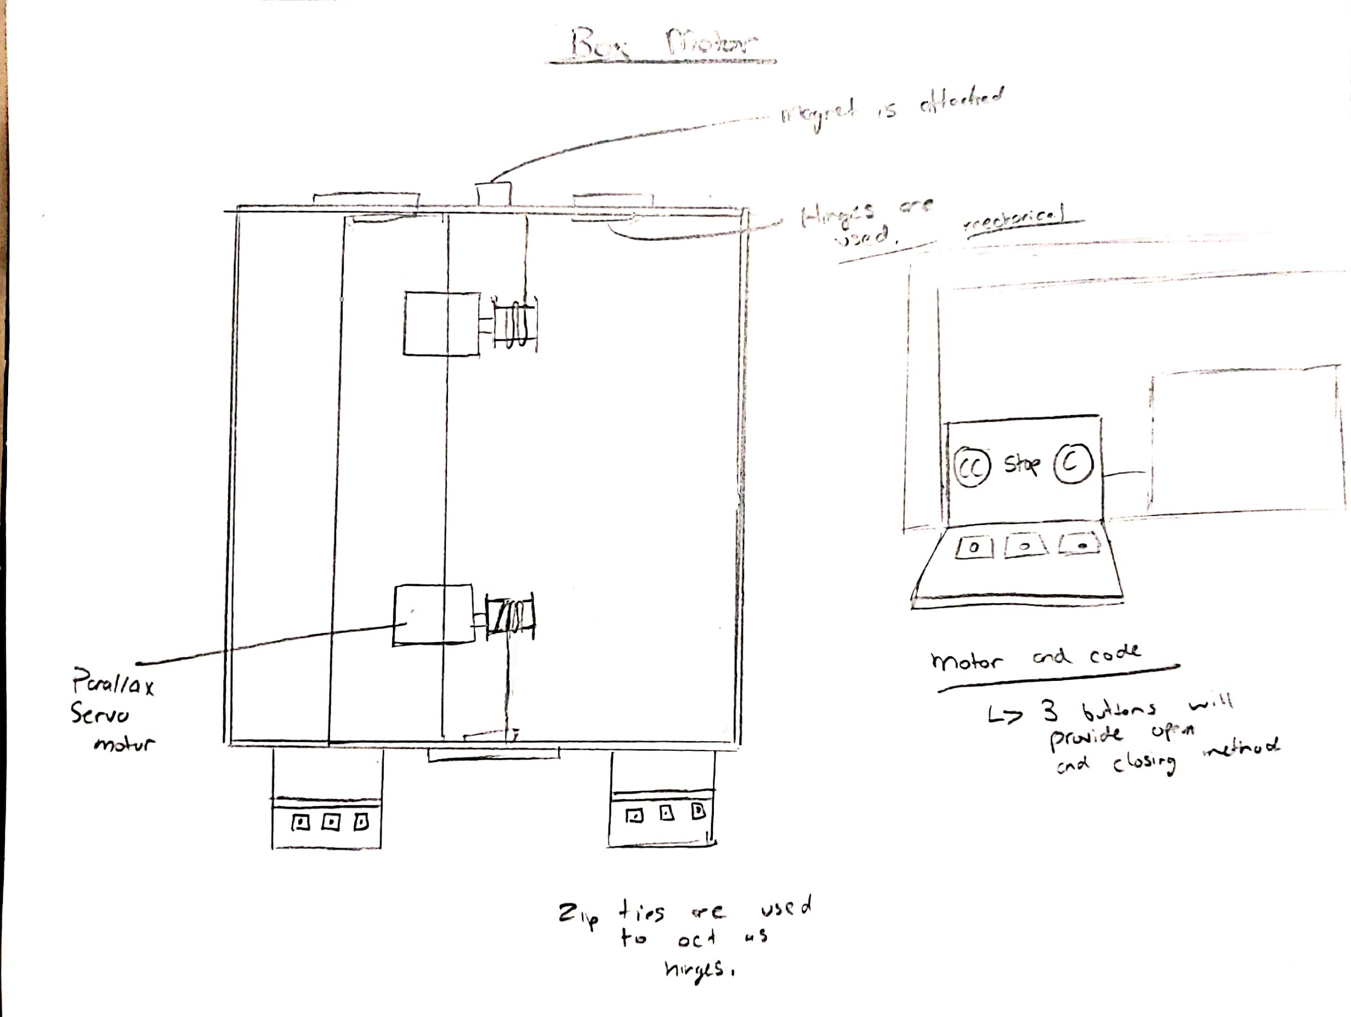
Box Motor

Slide 12
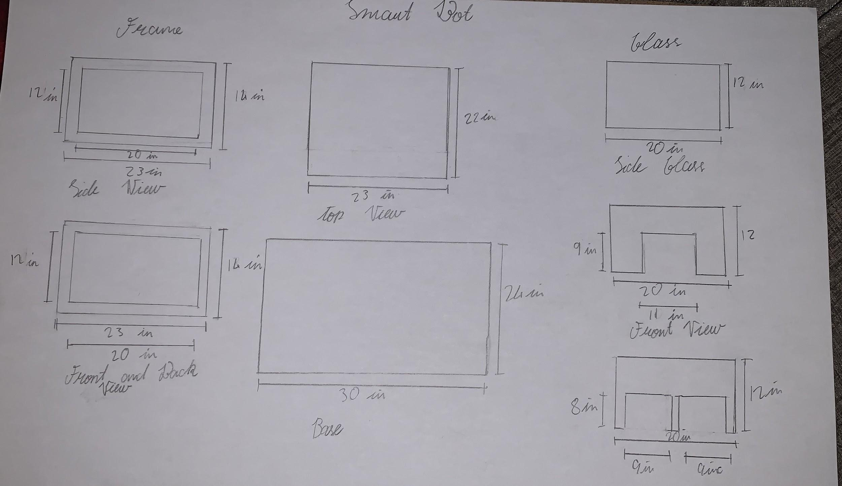
Sketches - Box

Slide 13
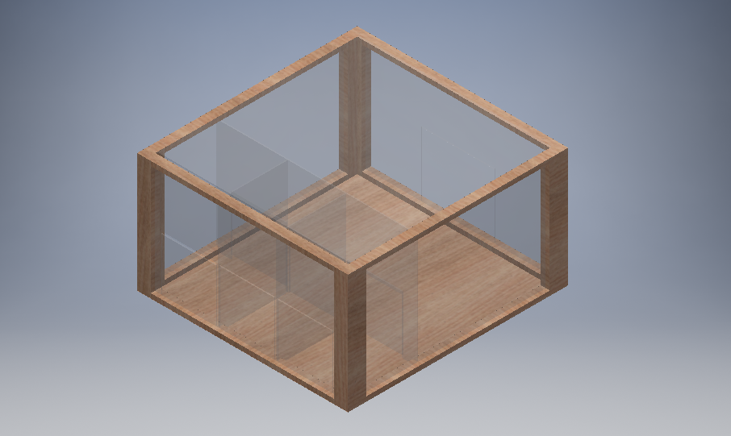
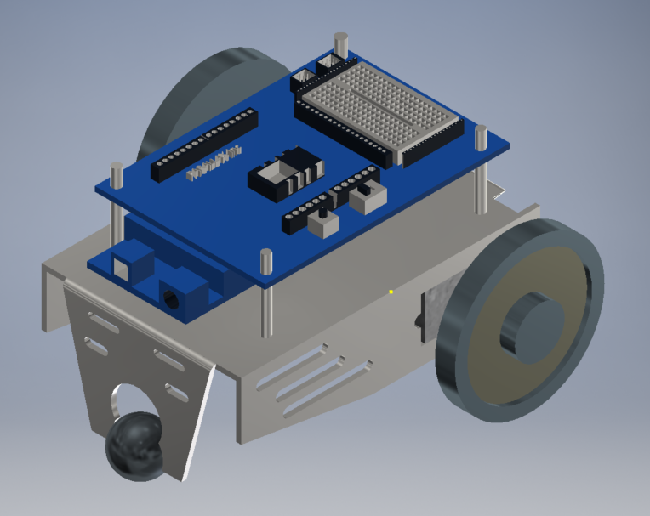
Prototype Design

Slide 14
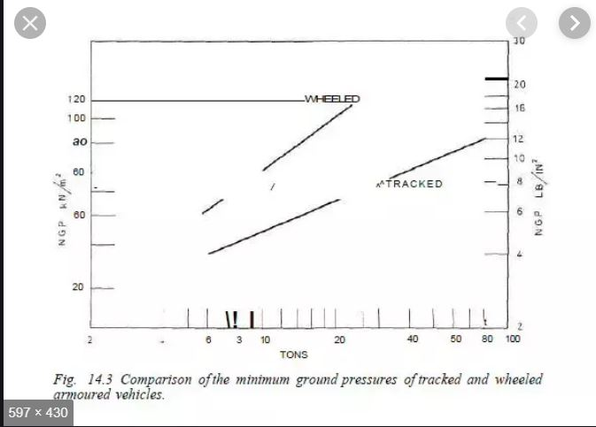

Slide 15
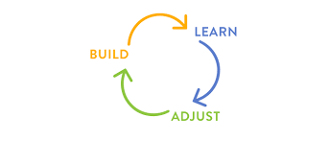
Refine The Design
This was the process of iteration used once again. Then after carefully analyzing my sketches and my notes I was able to make a CAD which included all of my improvements. I systhenzised all of my concepts about robot and took into considerations of the design constraints given by the box.

Slide 16
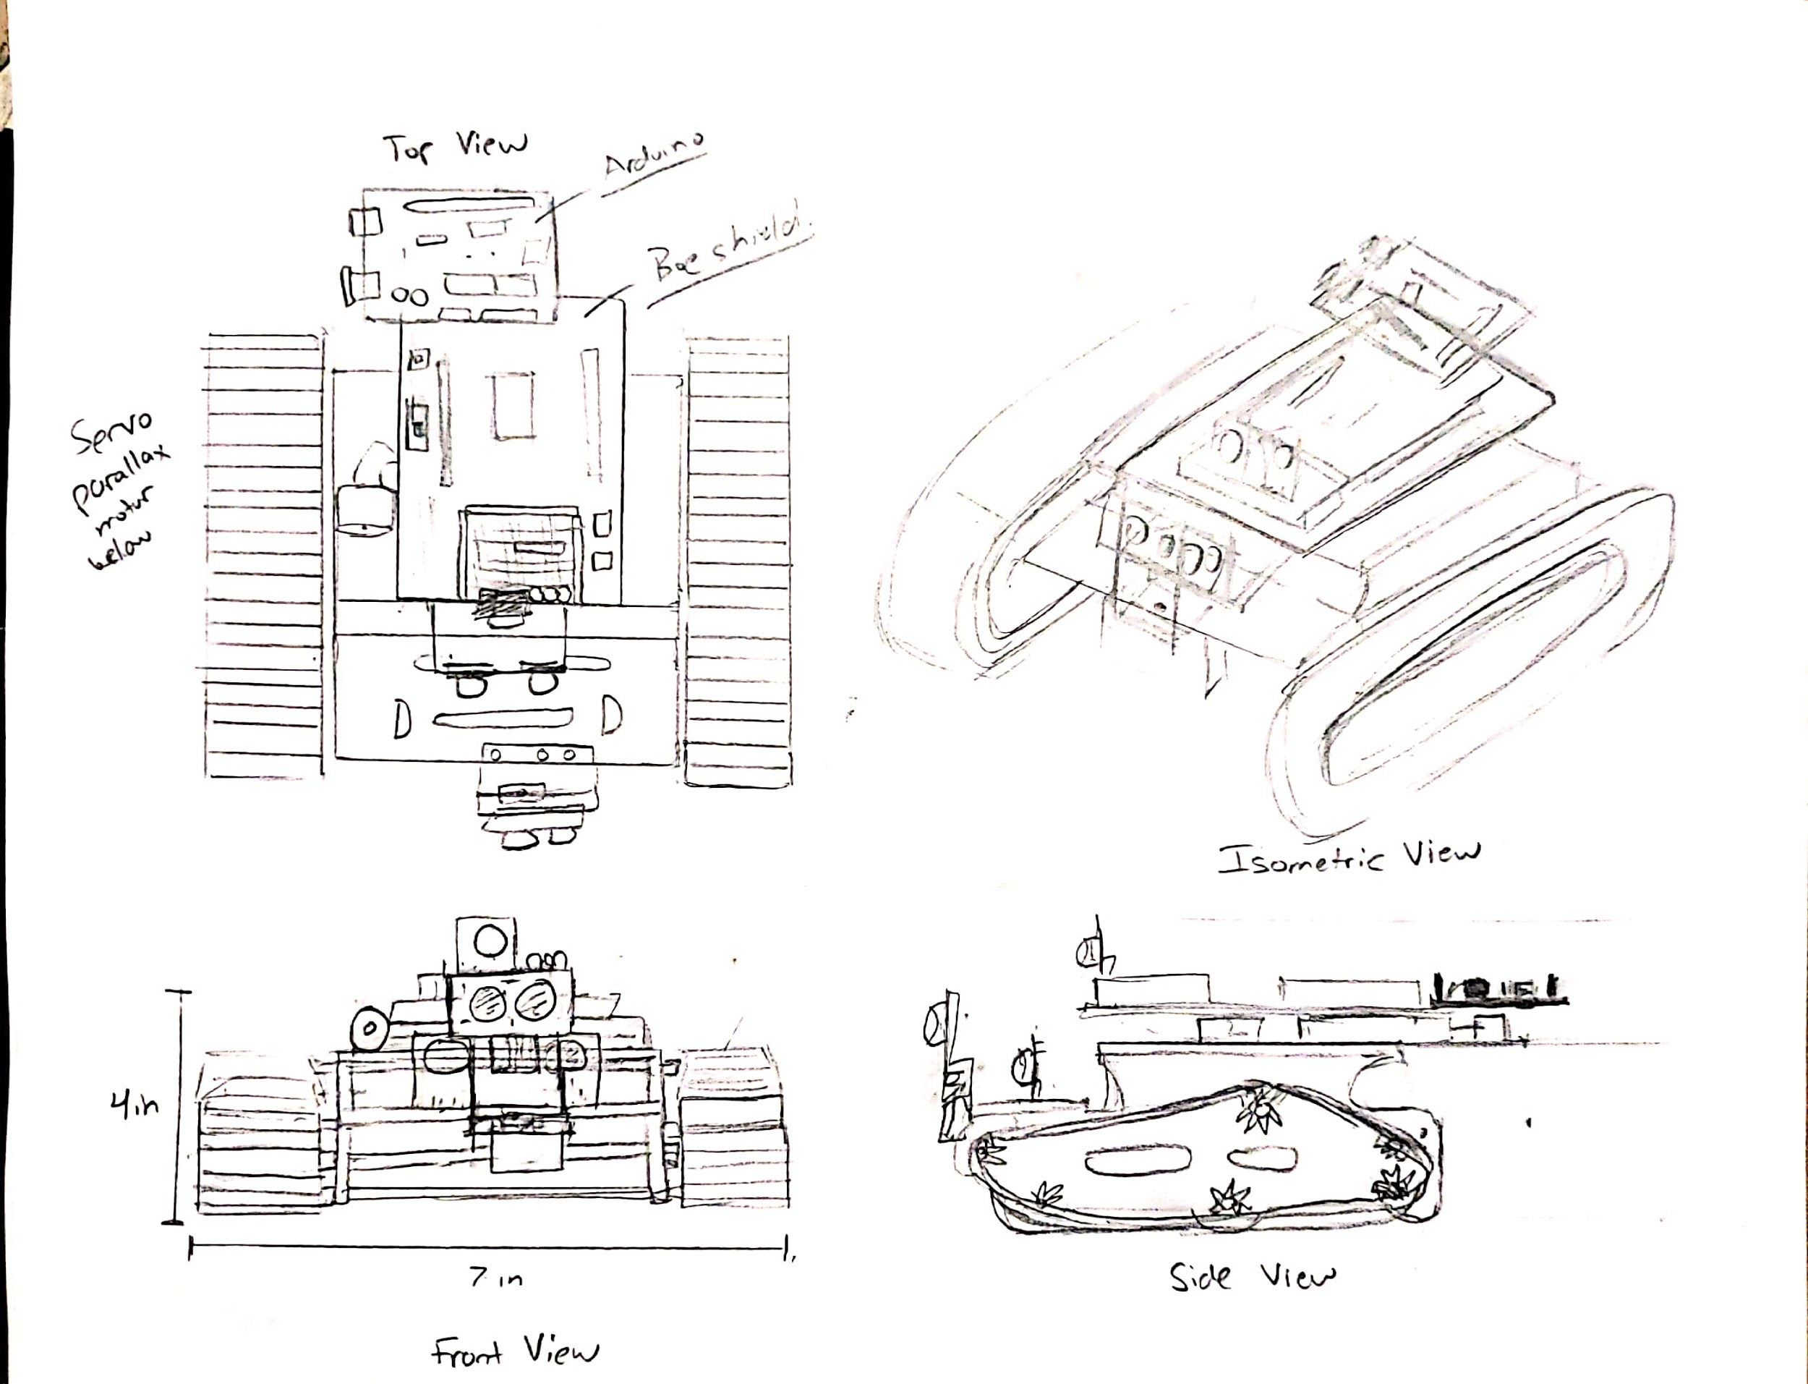

Slide 17
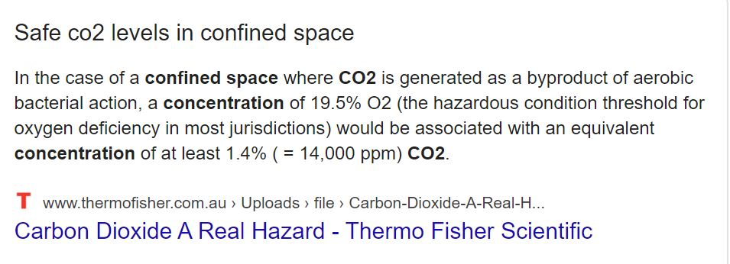
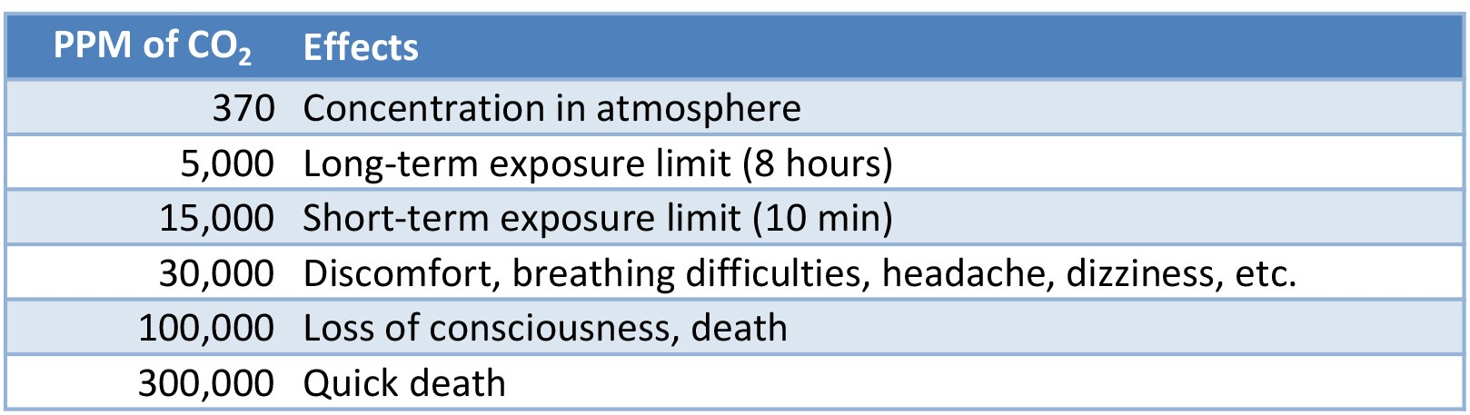
Human Factors:
Research on the average threshold of CO₂ , Hydrogen and Natural gas safe in the environment.
It was important that I looked into this as it would provide better results when used by the customer of this product. This project will not only provide customer satisfaction but also exceed expectations and create excitement in the market.

Slide 18
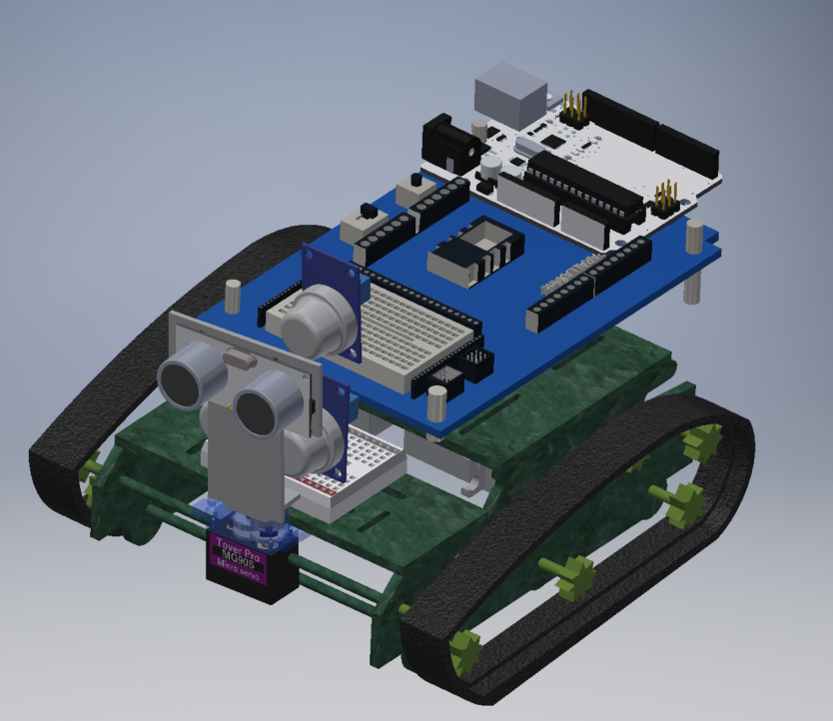
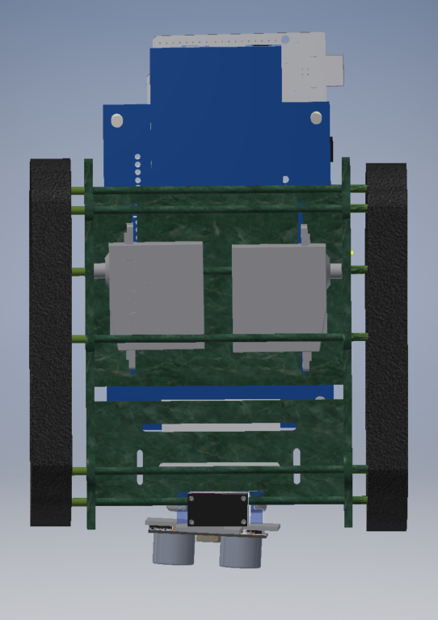
CAD- Robot

Slide 19
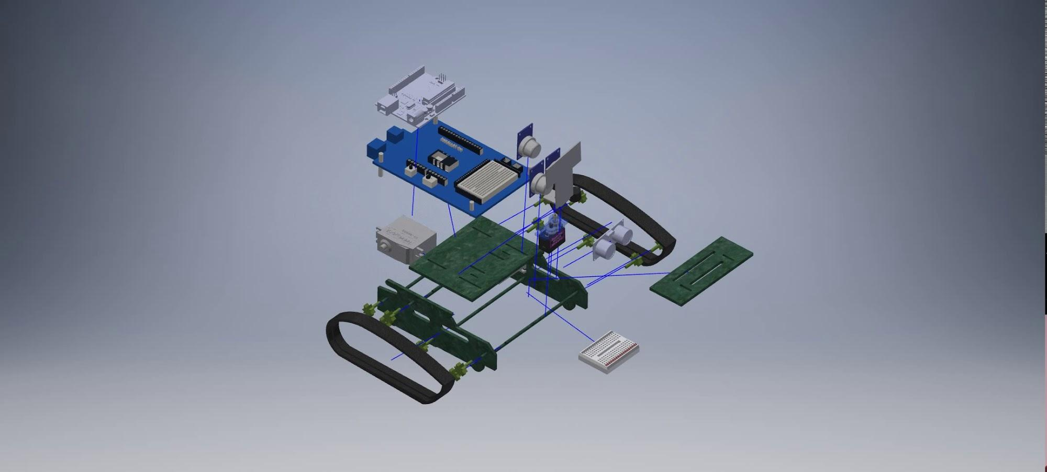

Slide 20
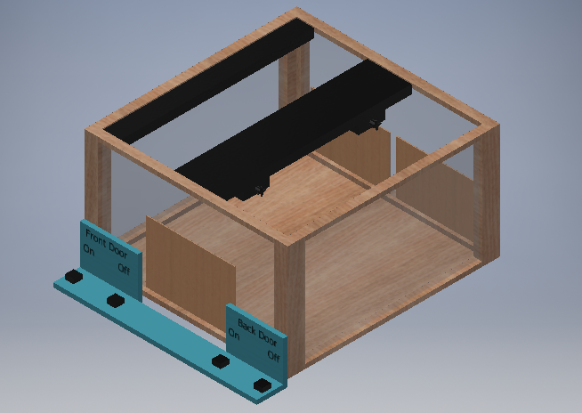

Slide 21
CAD - Box

Slide 22
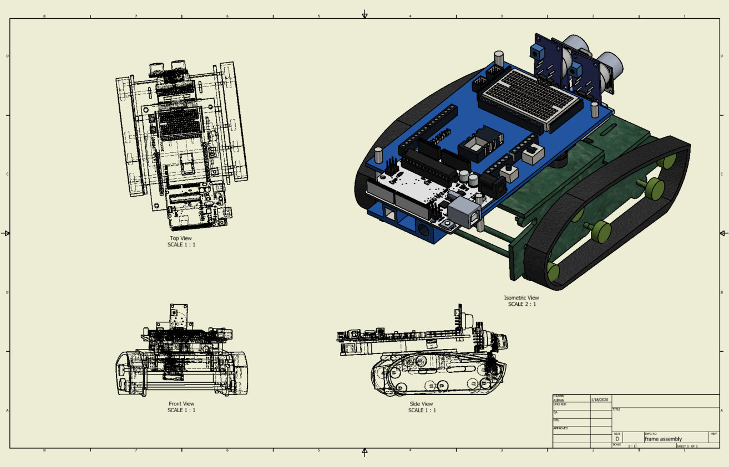
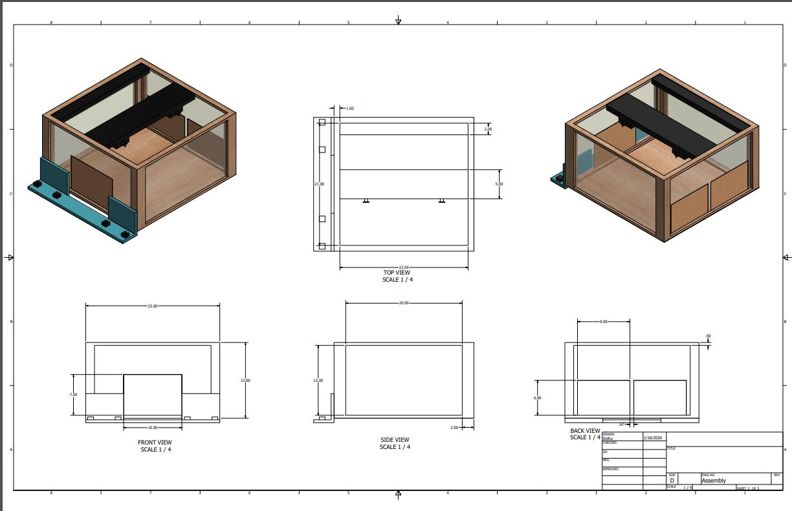

Slide 23
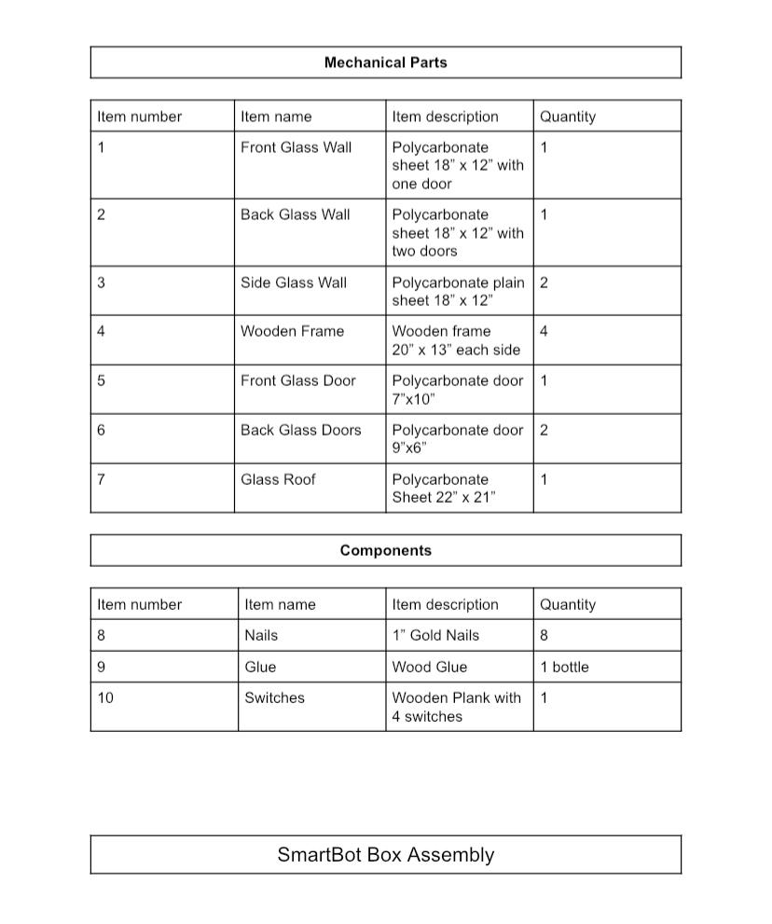
Materials

Slide 24
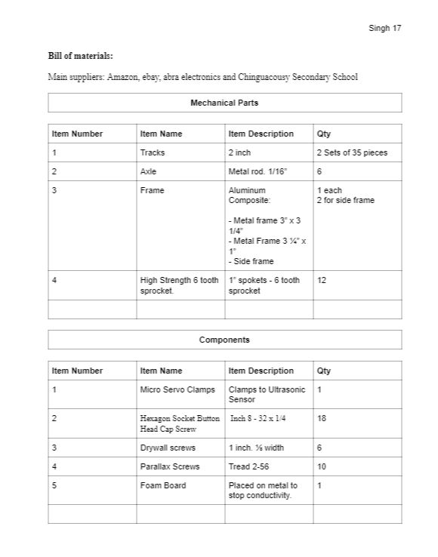

Slide 25

Construction

Slide 26
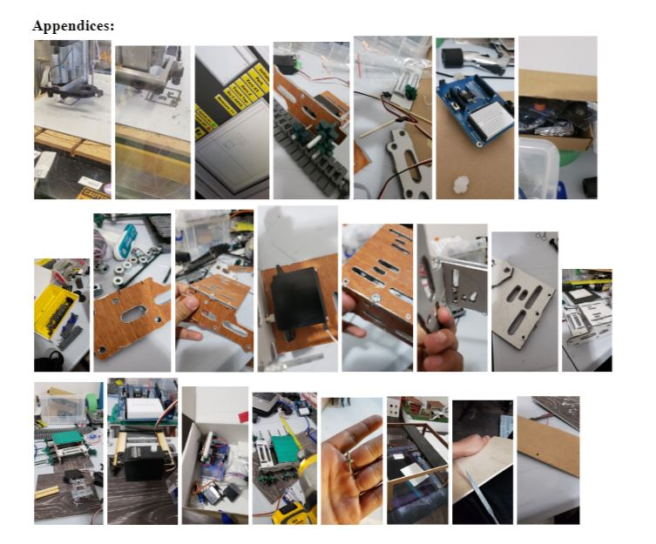

Slide 27
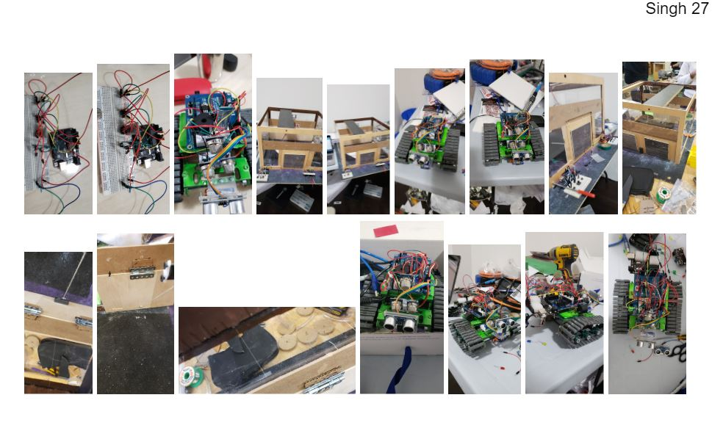

Slide 28
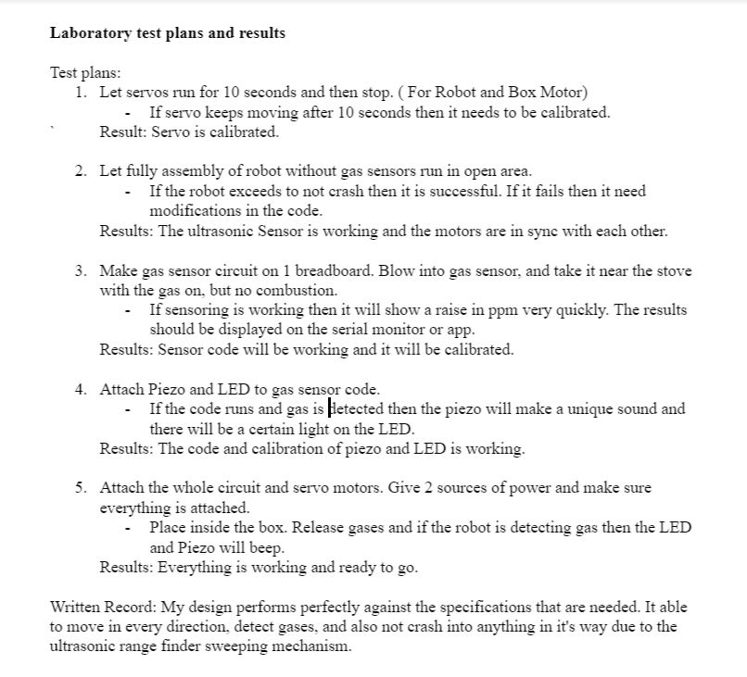
Evaluation

Slide 29

Ethical Consideration
There is a huge market for these types of products in the human resources/firefighters and etc. Nothing in the market has been made with this simplicity but also with the amount of detail into each phase of the product. There is a need for stuff like this in the market and the excitement level would also be driving this thing forward as this will be a fully autonomous robot.

Slide 30
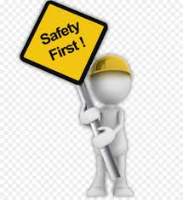
Safety
The robot is reducing the jobs of many firefighters, gas detecting people, and etc. It is reducing the risk of any type of fatalities that can occur during these jobs. This robot can do the same jobs and even do it better as the computers are made by humans to be smarter than humans. This robot is reducing “the human to dangerous situations” physical contact.

Slide 31
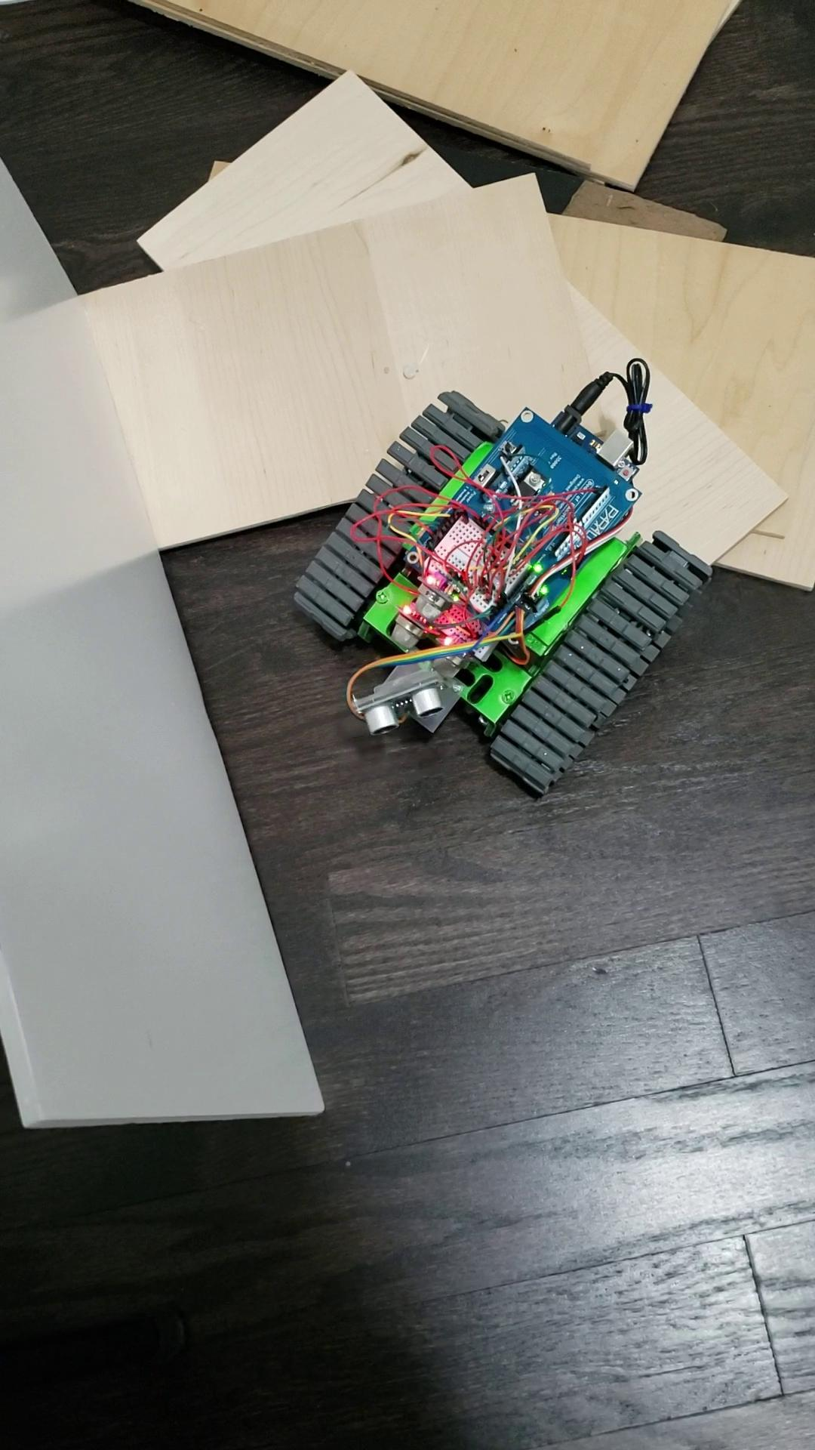
Final Product

Slide 32
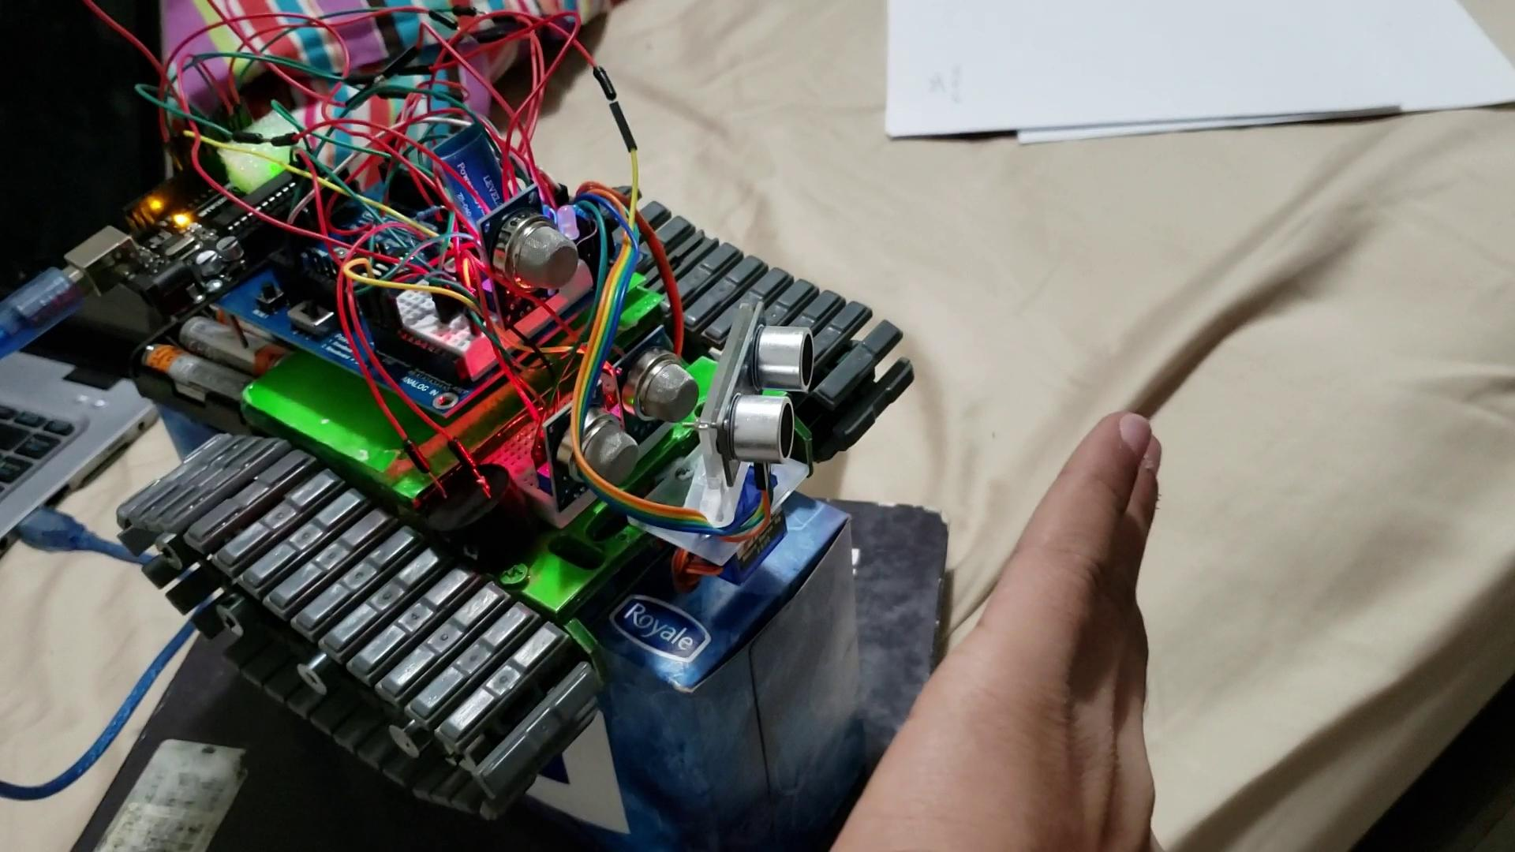

Slide 33
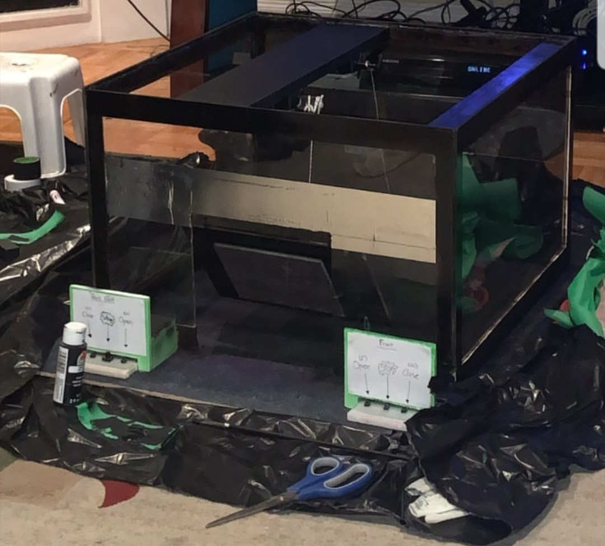

Slide 34

Next Steps
Make the arduino robot with no blindspot
The robot frame should be covered to the top and there should be no way for liquids or anything to leak through.
Make the Box more aesthetically pleasing
Add obstacles for the robot to pass through

